Slide 1



PHARMACOVIGILANCE ADVERSE EVENT PROCESSING SYSTEM
PRESENTED BY
HARI KRISHNAN P B
2026 - https://www.agilisium.com

Slide 2
PROBLEM STATEMENT
Pharmacovigilance teams manage large volumes of unstructured adverse event reports. Manual seriousness assessment is slow, inconsistent, and not scalable, causing delays in safety signal detection and regulatory compliance.
Fully automated AI approaches are unsuitable due to the need for transparency and human oversight. Therefore, a hybrid decision-support system combining machine learning, rule-based escalation, and expert review is required.
2026 - https://www.agilisium.com

Slide 3
PROPOSED SOLUTION
  Retrieval & Enrichment : Historical adverse event cases and regulatory context are retrieved from a vector database to enrich incoming reports.
  ML Classification : A machine learning model predicts event seriousness (serious vs. non-serious)
  Rule-Based Escalation : Predefined regulatory rules classify events as low,
2026 - https://www.agilisium.com

Slide 4
AI Reasoning : Reviews ML predictions against retrieved context and flags potential inconsistencies for transparency.
AI Explanation : Generates a concise summary of the adverse event report, highlighting key details such as drug name, event description, and risk indicators
Alerting Mechanism : Critical events automatically trigger email notifications to notify relevant stakeholders for immediate attention.
2026 - https://www.agilisium.com

Slide 5
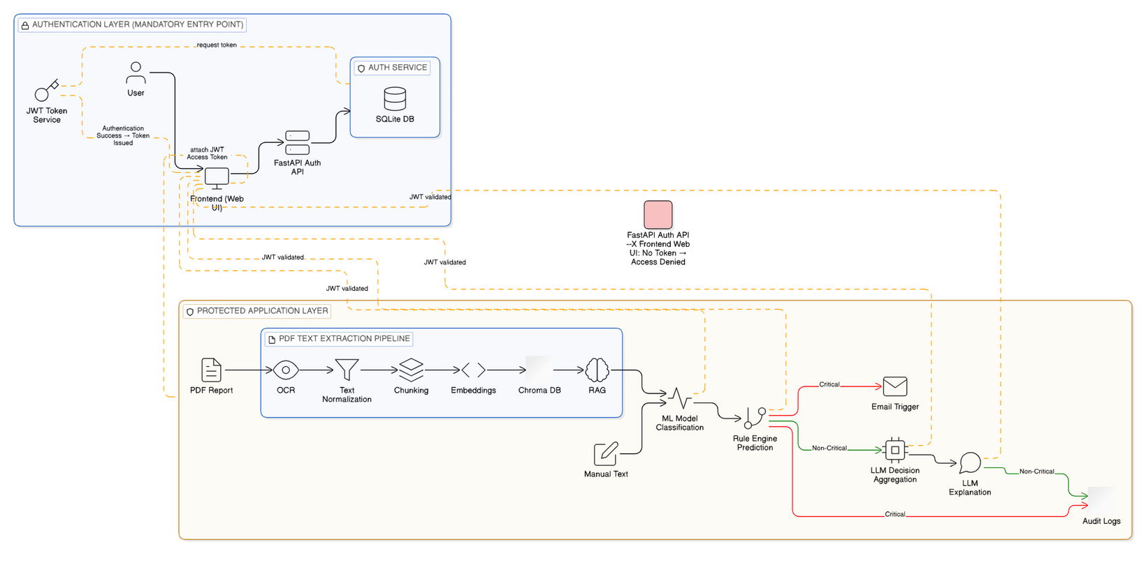
ARCHITECTURE DIAGRAM
2026 - https://www.agilisium.com

Slide 6
ALGORITHM USED
  The classification model is built using Logistic Regression, a weight-based supervised learning algorithm.
REASON
  Logistic Regression was selected due to its effectiveness in handling the imbalanced class distribution (Serious : Non-Serious ≈ 1 : 5.4) through weight-based classification.dy text
2026 - https://www.agilisium.com

Slide 7
WHY
  Three algorithms were considered for the classification task: Naive Bayes, Support Vector Machine (SVM), and Logistic Regression.
  Naive Bayes : It may perform poorly due to its strong feature independence assumption on text data.
  SVM : It can be computationally expensive and provides limited probability interpretability for imbalanced datasets.
  Logistic Regression : It as it offers weight-based, interpretable predictions and handles class imbalance more effectively.
2026 - https://www.agilisium.com

Slide 8
RETRIVAL & ENRICHMENT
  When an adverse event report is received, the text is split into sentences and converted into semantic vectors using a sentence transformer.
  These vectors are stored in a vector database along with historical adverse event cases and regulatory information. Using RAG, the system retrieves the most relevant past cases and context based on similarity.
  This retrieved information enriches the incoming report before it is passed to the machine learning classification model.
2026 - https://www.agilisium.com

Slide 9
ML CLASSIFICATION
  The ML classification model is built using Logistic Regression, a weight-based supervised learning algorithm, with TF-IDF features extracted from adverse event text.
  The model predicts whether an event is Serious or Non-Serious. Since missing serious cases can impact patient safety, recall is prioritized as the primary evaluation metric.
  To handle class imbalance, class weighting and decision-threshold tuning are applied to achieve high recall while controlling false positives.
2026 - https://www.agilisium.com

Slide 10
RULE BASED ESCALATION
  The rule-based engine scans adverse event text for predefined high-risk medical and regulatory keywords such as hospitalization, death, ICU admission, and life-threatening conditions.
  If any of these keywords are detected, the event is immediately classified as Serious, overriding the ML prediction. For cases without explicit high-risk indicators, the ML prediction is evaluated using a tuned seriousness threshold to prioritize recall.
  This approach helps reduce the risk of missing critical events. Overall, the rule-based engine improves transparency, supports regulatory compliance, and strengthens patient safety.
2026 - https://www.agilisium.com

Slide 11
AI REASONING
  The AI reasoning component provides medical context and interpretability for the machine learning classifier’s predictions. It uses a Gemma 2:2B to analyze the adverse event description along with the ML prediction and confidence score.
  The AI generates concise medical reasoning indicating whether the ML prediction is supported or potentially challenged.
  The AI does not approve, reject, or override the ML decision. Instead, it helps flag cases that may require closer human review, improving transparency and trust in the system.
2026 - https://www.agilisium.com

Slide 12
AI EXPLANATION
  The AI explanation component generates a short, clinical justification for each adverse event classification. It uses a lightweight llama 3.1 to explain why an event was classified as serious or non-serious based on ML output and rule-based indicators.
  The explanation considers the drug name, adverse event description, probability score, triggered keywords, and assigned risk level.
  Its role is limited to improving transparency and interpretability. If the AI service is unavailable, the system continues safely without generating an explanation.
2026 - https://www.agilisium.com

Slide 13
ALERTING MECHANISM
  The Email Escalation Service is used to alert safety officers whenever a report is identified as serious or critical.
  When triggered, it sends a simple text-based email using preconfigured SMTP settings.
  The email contains important information such as the report ID, drug name, adverse event details, risk level, and the explanation generated by the system.
  This helps ensure that high-risk cases are reviewed without delay.
2026 - https://www.agilisium.com

Slide 14
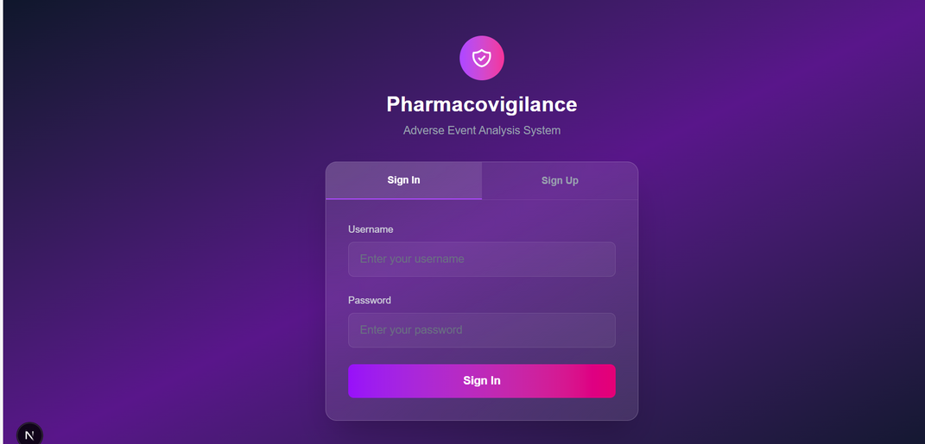
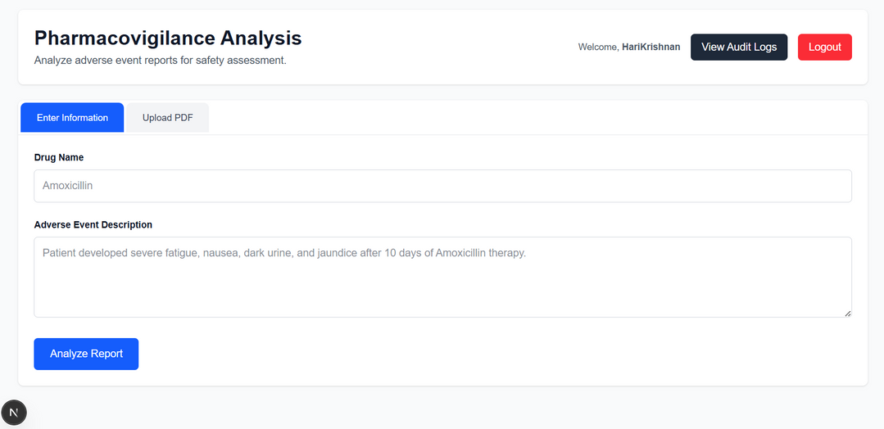
OUTPUT
2026 - https://www.agilisium.com

Slide 15
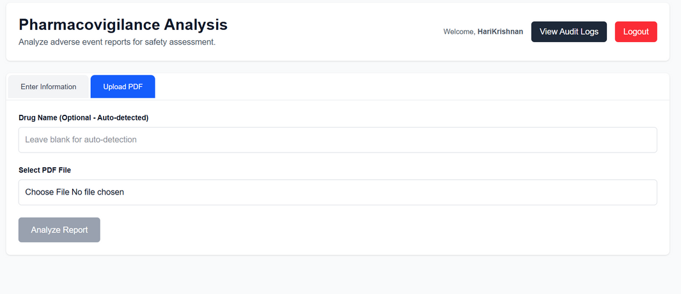
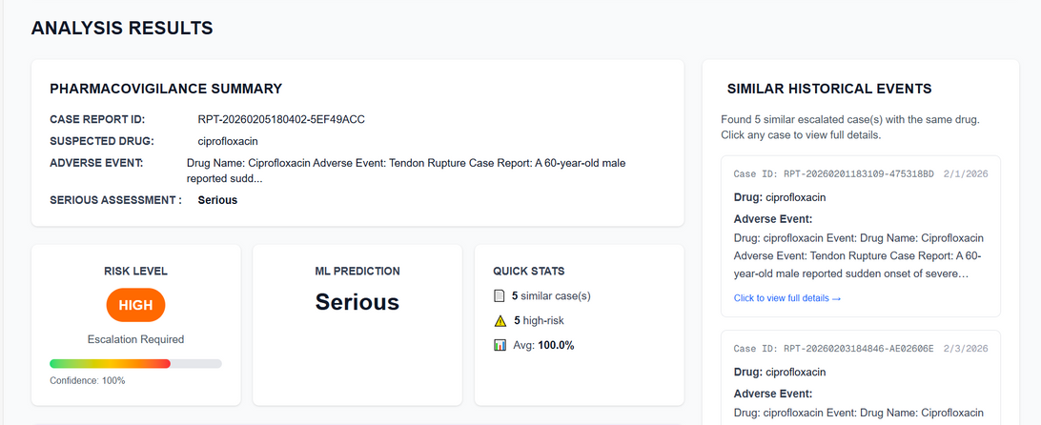
2026 - https://www.agilisium.com

Slide 16
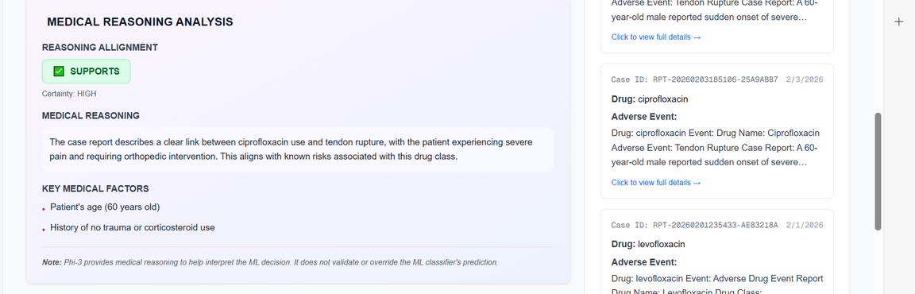
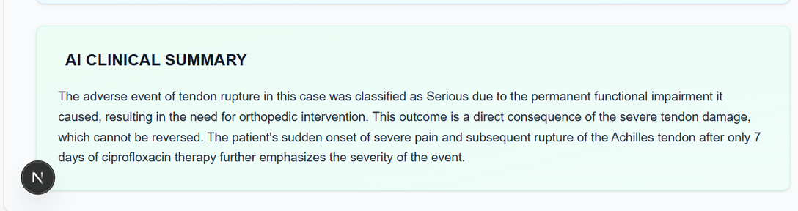
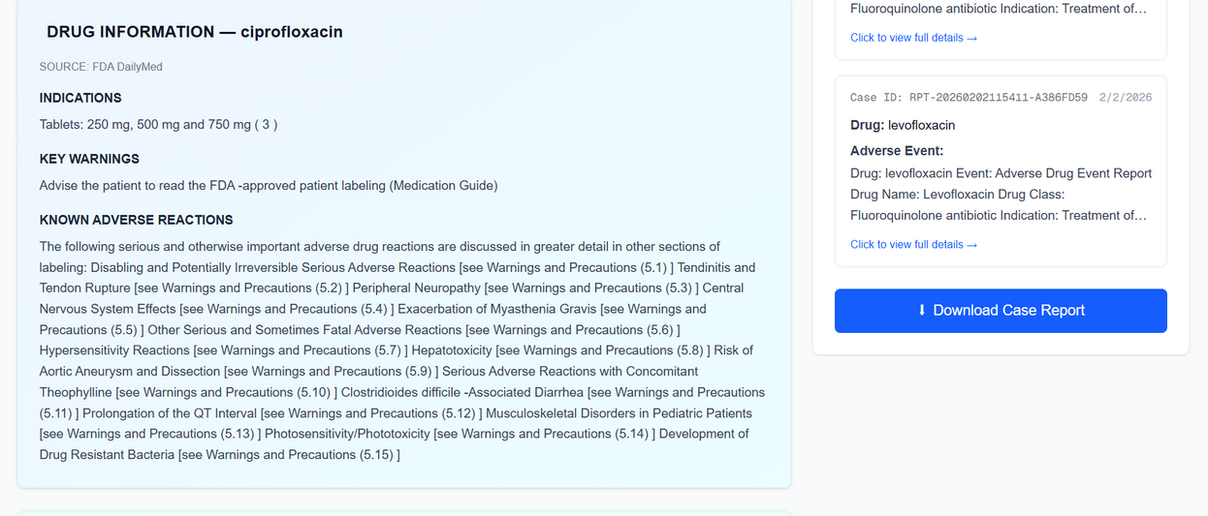
2026 - https://www.agilisium.com

Slide 17
CONCLUSION
  This project implements a hybrid pharmacovigilance system that combines machine learning, rule-based escalation, and AI-driven explanations to support adverse event processing.
  The approach improves efficiency and consistency while prioritizing patient safety and regulatory compliance. Critical cases are automatically escalated for timely human review, with final decisions remaining under expert control.
2026 - https://www.agilisium.com

Slide 18
FUTURE DIRECTIONS
  The system can be enhanced by using larger and more diverse datasets to improve robustness.
  Advanced techniques for handling class imbalance and regular model retraining can improve detection of rare serious events.
  Integration with real-time reporting systems may enable faster safety signal detection.
2026 - https://www.agilisium.com

Slide 19



Thank You

